Slide 1
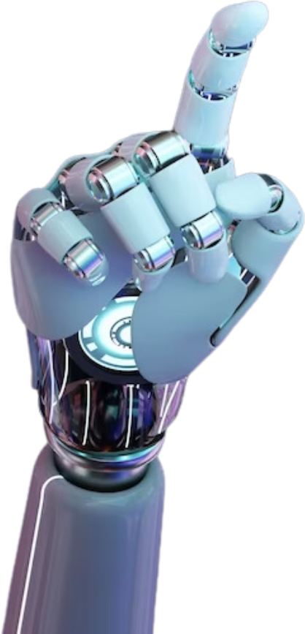


ENGINEER IBRAHIM AL-TAAMARI
WHISPERVOIDXAI ACADEMY| 2025
Artificial Intelligence

Slide 2
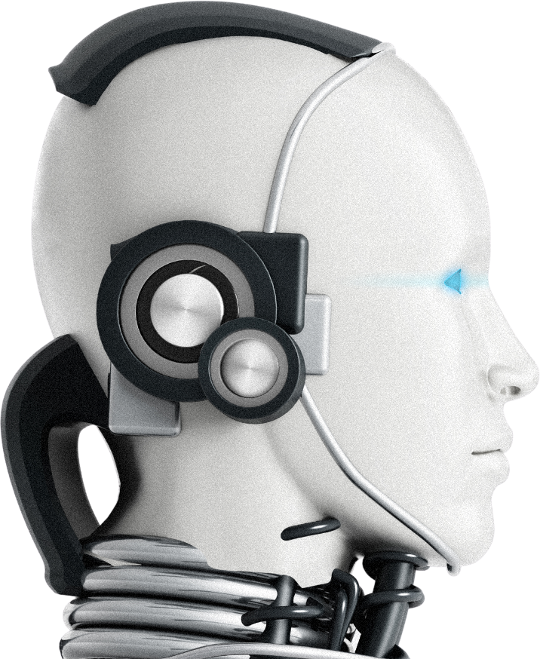
ENGINEER IBRAHIM AL-TAAMARI
ANALYZING BUILDING DATA AND BUILDING A PREDICTIVE MODEL FOR ENERGY EFFICIENCY
OBJECTIVE: TO ESTIMATE THE ENERGY STAR SCORE FOR BUILDINGS USING ENERGY AND WATER CONSUMPTION DATA.
BASIC STEPS:
DATA LOADING AND PROCESSING (CLEANING MISSING VALUES, TRANSFORMING NUMERIC AND TEMPORAL COLUMNS).
DATA VISUALIZATION (SCORE DISTRIBUTION, VARIANCES BETWEEN BUILDINGS).
FEATURE PREPARATION (NUMERIC AND CATEGORICAL) AND THE TARGET COLUMN FOR THE MODEL.

Slide 3

ENGINEER IBRAHIM AL-TAAMARI
GRADIENT BOOSTING MODEL TRAINING AND EVALUATION
GRADIENT BOOSTING REGRESSOR WAS USED TO PREDICT POWER SCORES.
PRE-TRAINING PROCESSING STEPS:
FILL MISSING VALUES ​​USING MEDIAN IMPUTATION.
NORMALIZE DATA USING MINMAXSCALER.
POST-TRAINING:
EXTRACT FEATURE IMPORTANCE TO IDENTIFY THE MOST INFLUENTIAL FACTORS.
IDENTIFY THE SAMPLE WITH THE LARGEST ERROR FOR REVIEW.

Slide 4

ENGINEER IBRAHIM AL-TAAMARI
VISUALLY INTERPRET MODELS WITH LIME
USE LIME TO INTERPRET INDIVIDUAL MODEL ERRORS.
VIEW AN INDIVIDUAL TREE FROM THE MODEL TO UNDERSTAND INTERNAL DECISIONS.
GRAPHS SHOW:
THE 10 MOST IMPORTANT FEATURES AFFECTING THE MODEL.
DETAILED INTERPRETATION OF THE SAMPLE WITH THE LARGEST DIFFERENCE BETWEEN THE PREDICTION AND THE ACTUAL VALUE.

Slide 5

ENGINEER IBRAHIM AL-TAAMARI
WHISPERVOIDXAI ACADEMY| 2025
PROJECT NOTES
THIS PROJECT HELPS PRESENT RESULTS TO END USERS OR DECISION MAKERS IN A CLEAR AND UNDERSTANDABLE MANNER.
THE MODEL IS ROBUST AND REALISTIC, PROVIDING PRACTICAL INFORMATION ABOUT THE IMPACT OF EACH FEATURE ON THE OUTCOME.
THE CODE IS BASED ON REAL-WORLD DATA AND APPLIES PRACTICAL DATA PROCESSING METHODS BEFORE TRAINING.
HTTPS://GITHUB.COM/WHISPERVOIDXAI/PROJECTAI
HTTPS://WWW.INSTAGRAM.COM/WHISPERVOIDXAI/

